Slide 1
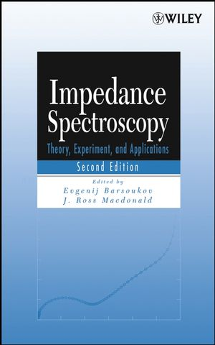
Impedance Spectroscopy
Using the Matlab program
ZfitGUI
Theory and other things may be found in the Macdonal book and here :
https://sites.google.com/site/jeanlucdellis (in the « programmes Matlab » and in the « Spectroscopie d’Impédance» repertories)

Slide 2
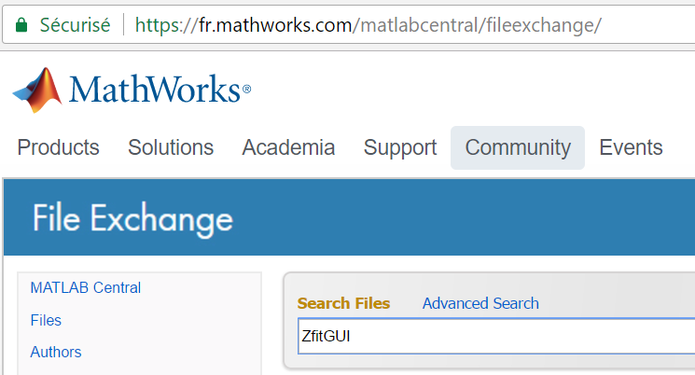
Download the Matlab program ZfitGUI
Z fit GUI
Graphical
User
Interface
Impédance Z
Fit : search for the best parameters of an Equivalent Circuit

Slide 3
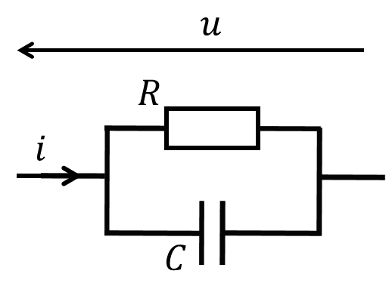
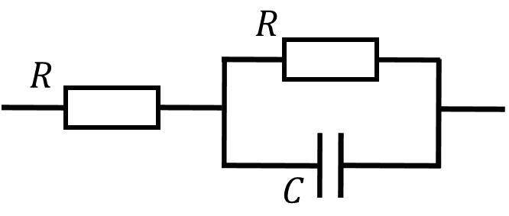
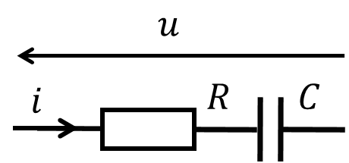
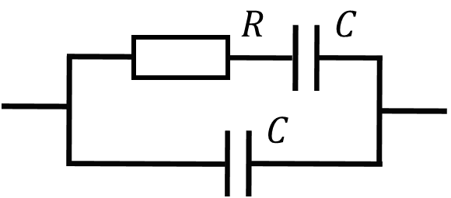
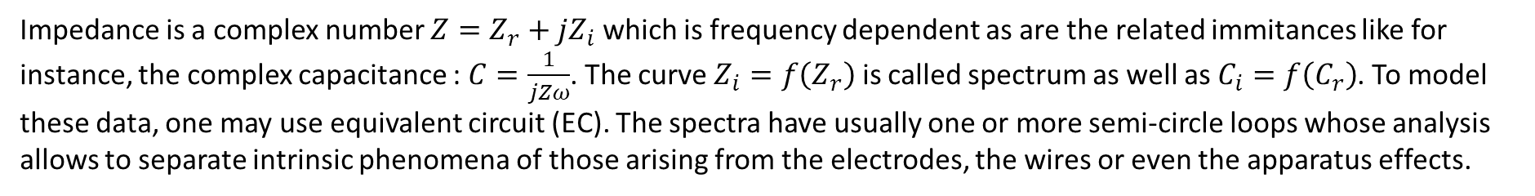
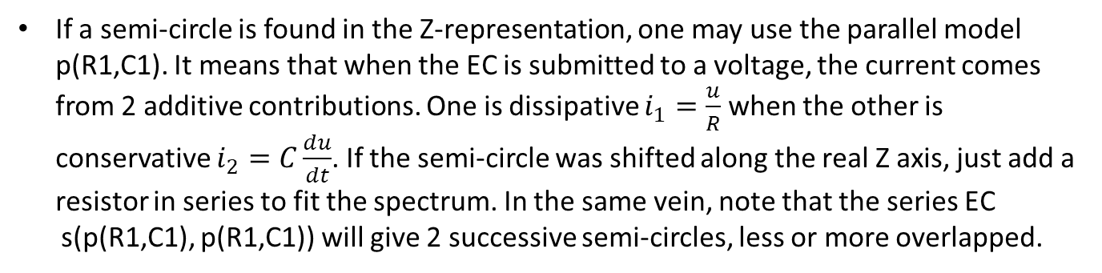
Preambule
Impedance is a complex number $Z=Z_{r}+jZ_{i}$ which is frequency dependent as are the related immitances like for instance, the complex capacitance : $C=\frac{1}{jZω}$. The curve $Z_{i}=f\left(Z_{r}\right)$ is called spectrum as well as $C_{i}=f\left(C_{r}\right)$. To model these data, one may use equivalent circuit (EC). The spectra have usually one or more semi-circle loops whose analysis allows to separate intrinsic phenomena of those arising from the electrodes, the wires or even the apparatus effects.
If a semi-circle is found in the Z-representation, one may use the parallel model p(R1,C1). It means that when the EC is submitted to a voltage, the current comes from 2 additive contributions. One is dissipative $i_{1}=\frac{u}{R}$ when the other is conservative $i_{2}=C\frac{du}{dt}$. If the semi-circle was shifted along the real Z axis, just add a resistor in series to fit the spectrum. In the same vein, note that the series EC
s(p(R1,C1), p(R1,C1)) will give 2 successive semi-circles, less or more overlapped.
If the semi-circle was found in the C-representation, the right EC is the serial Debye model s(R1,C1) with only one current usually attributed to the material
polarization and which equilibrium is delayed by the resistor. If the semi-circle was shifted along the real C axis, just add a capacitor in parallel to fit the data. Here also, we may find 2 successive semi-circles but the model would be : p(s(R1,C1), s(R1,C1)) .

Slide 4

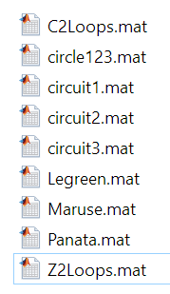

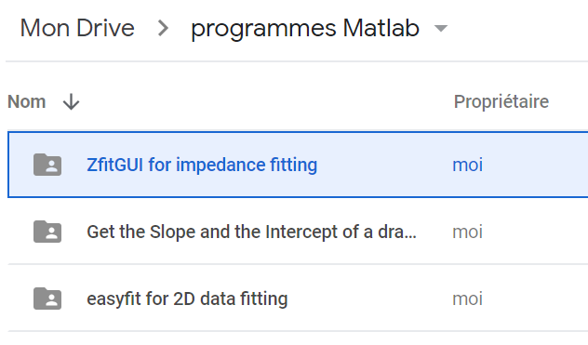
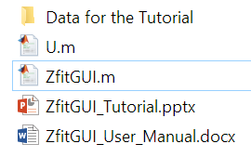
Download simulations and experimantal data
In Internet, search for the google web site « jeanlucdellis », navigate to the « programmes Matlab » repertory to download the files to process as trainings.
Download
Get the function ZfitGUI, the Tutorial and the User Manual

Slide 5

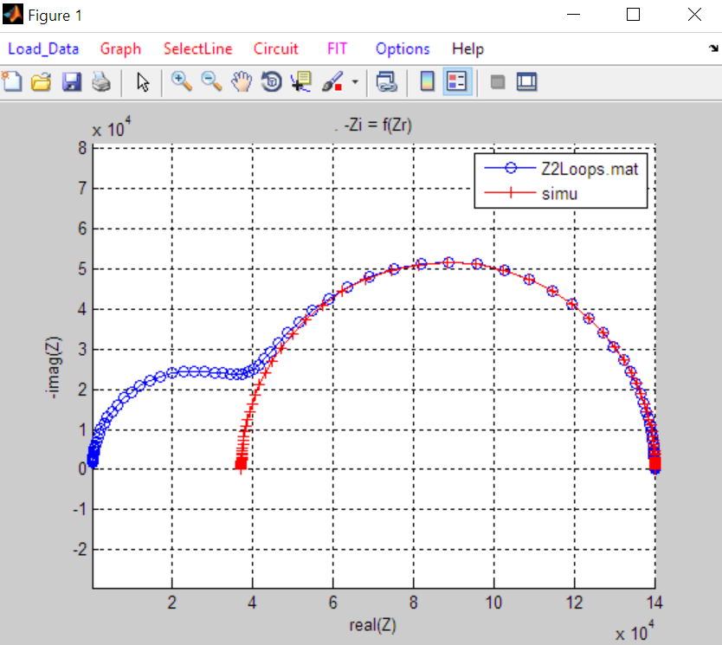
the Matlab program ZfitGUI adds UIMENUS to a figure
Type ZfitGUI without inputs :

Slide 6
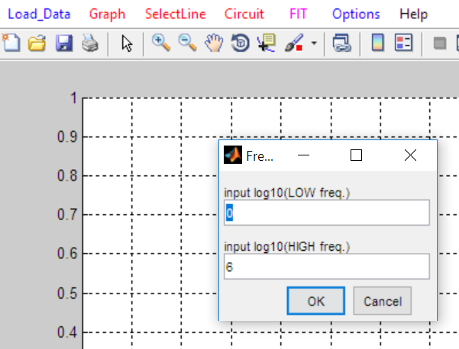
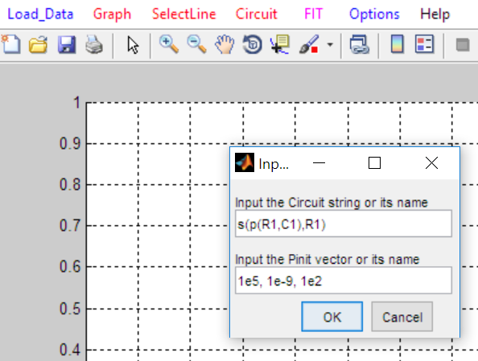
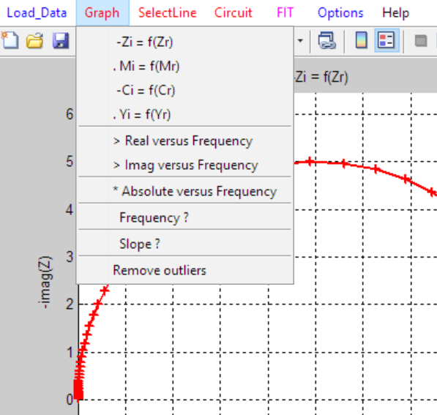
How to generate simulated Z-data
… and to enter the Circuit String. Default string is : s(p(R1, C1), R1).
‘s’ stands for ‘put in series’ and ‘p’ for ‘put in parallel’. These operators must have exactly 2 arguments. The numerals beside the element letters R (resistor) and C (capacitor) are reminders about the amount of parameters they need. L1 (inductor), E2 (CPE), G2, H2 (diffusion impedances) and even user-defined element may be used. Read the User Manual of ZfitGUI to have more details about them.
Click ‘Circuit’ to enter the frequency bounds.
Default : 1 Hz to 10⁶ Hz…
It is mandatory to enter values for the elements. Enter them as they come in the Circuit String.
Default : 5 10⁴, 10⁻⁹, 5 10³
Note that ‘Graph’ contains sub-menus

Slide 7
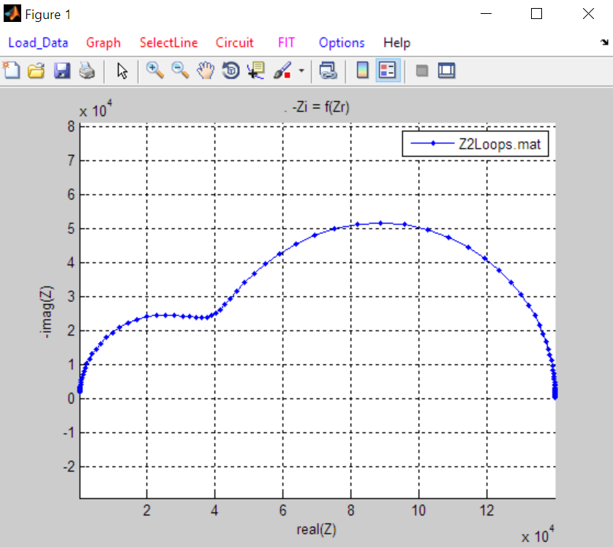
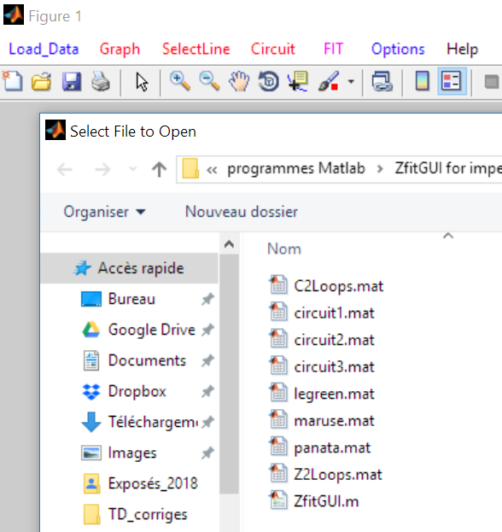
Z2Loops – Fitting a simulated Data of a conductive system (A)
Before to proceed, clean the figure with the « edit plot » tool (arrow of the menu), then right-click on the preceeding curve and delete it.
Click on the « Load Data » uimenu to load Z2Loops in ZfitGUI
Next step is to select the curve, write a Circuit string and feed it with initial values

Slide 8
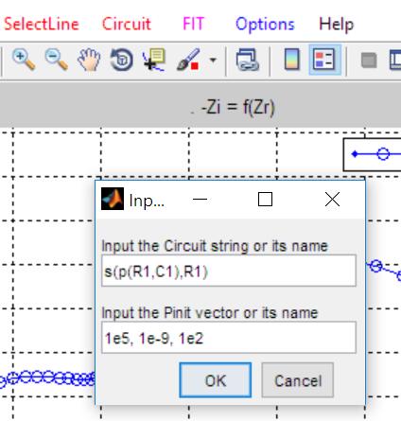
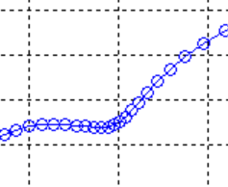
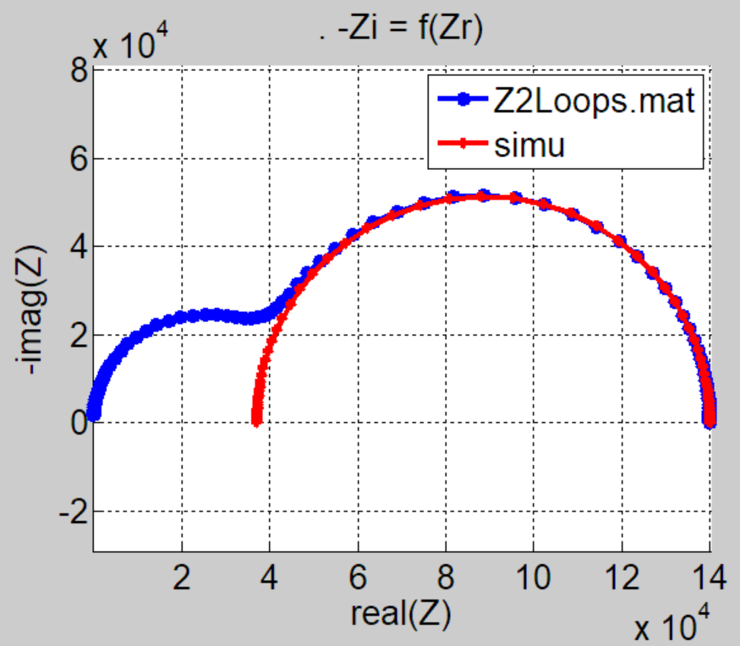
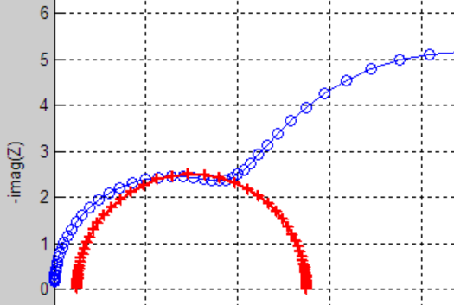
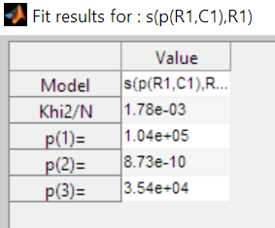
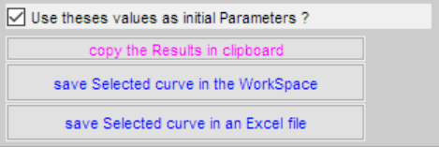
Z2Loops – Fitting of a simulated Data of a conductive system (B)
Click on «SelectLine » to process the curve
Click on « Circuit » to enter the Circuit string and the Pinit. As the spectra usually show loops, « s(p(R1,C1),R1) » is a good start because p(R1,C1) defines a semi-circle which can be translated along the real axis with the s( ,R1) operator
Click on «Fit», then twice on the large loop to fit it and …
… to get the results graphically and in the Result figure:
The tools in the bottom of the Result figure are very usefull :
Try to fit the whole spectrum with s(p(R1,C1), p(R1,C1))
Very usefull : the values in the Value colunm are editable. Change them to get a better initial parameters set.

Slide 9
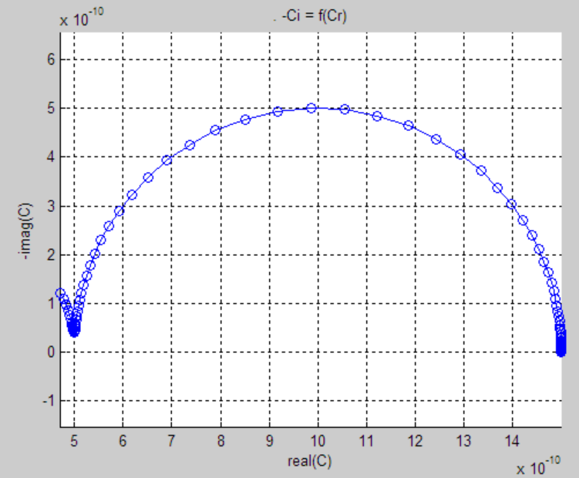
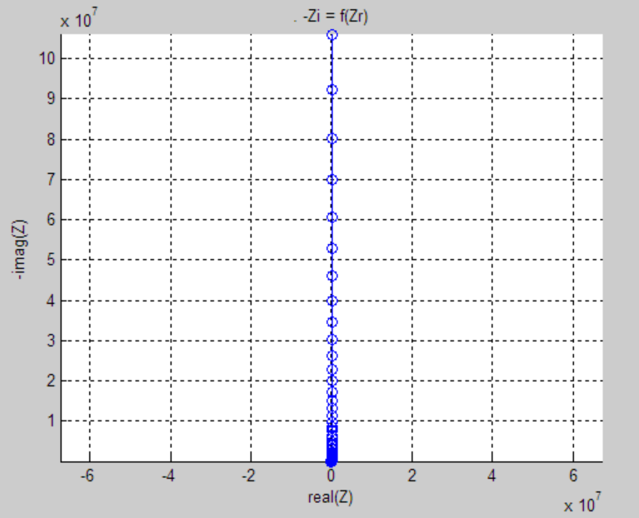
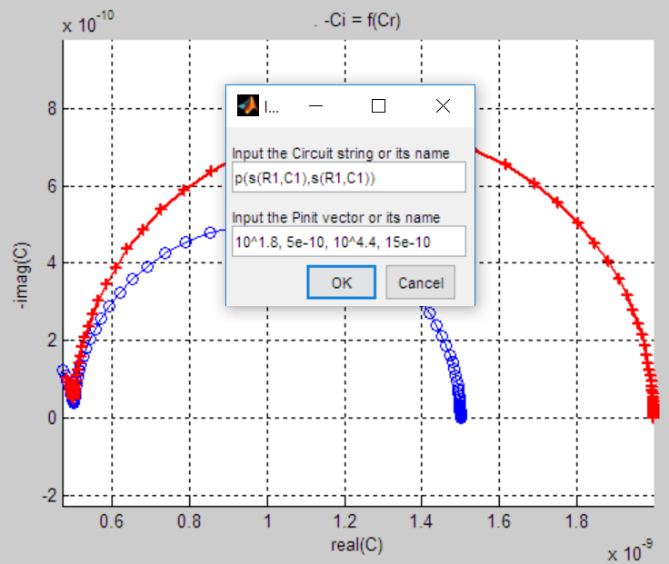
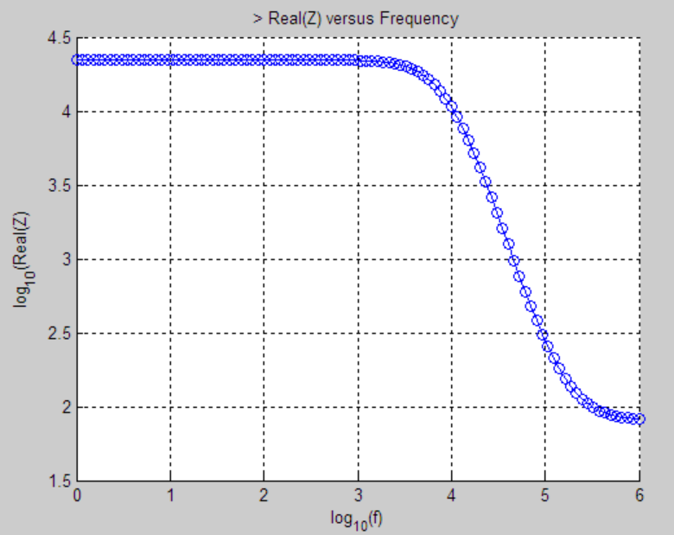
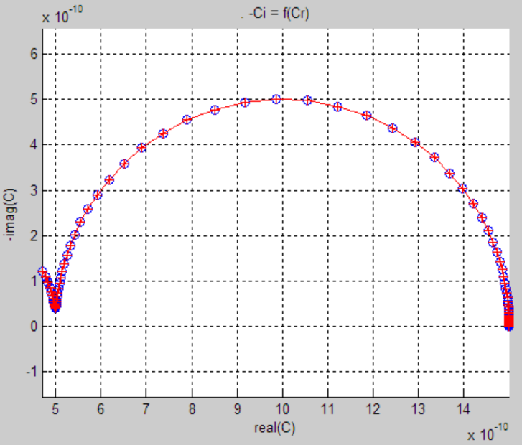
C2Loops – Fitting of a simulated Data of a dielectric system
When in « C » representation, for dielectric systems, 2 successive loops correspond to 2 Debye relaxations s(R1,C1) in parallel. So here, we will use the Circuit String : p(s(R1,C1), s(R1,C1)) and from the spectrum inspection, we shall start with capacitors 5 10⁻¹⁰ F (at HF) and 15 10⁻¹⁰ F (at LF).
It gives a main loop and the beginning of another at HF (checked in using ‘Graph, frequency?’)
Load ‘C2Loops’. One obtains a Z-spectrum looking like the one of a capacitor, lets switch to : ‘Graph, -Ci=f(Cr)’
One may examine the Re(Z) = f(ω) curve to get initial values 10^{4.4} Ω (at LF) and 10^{1.8} Ω (at HF) or use « Fit » and a try and error method.
The Initial parameters have little error in the C guesses but anyway, lets try « Fit »

Slide 10
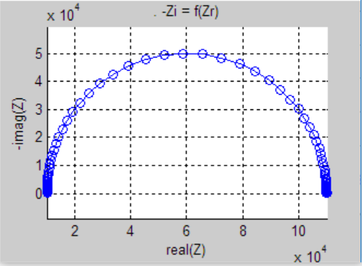

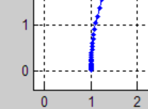

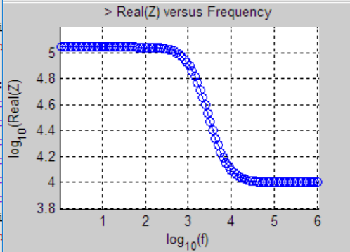

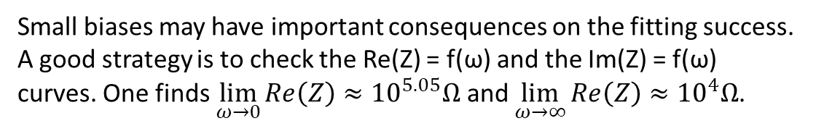
Circuit1 – Pay attention to low amplitude points
Procedure :
Inpect the spectrum. Here, we find with the tool and the zoom
that the semicircle is translated along the axis of the reals:
Small biases may have important consequences on the fitting success. A good strategy is to check the Re(Z) = f(ω) and the Im(Z) = f(ω) curves. One finds $\lim_{ω→0}{Re\left(Z\right)}≈{10}^{5.05}Ω$ and $\lim_{ω→∞}{Re\left(Z\right)}≈{10}^{4}Ω$.
s(R1, p(R1, C1)) is the right Circuit string.
Enter the model string after clicking on the "Circuit" menu and initial (guessed) values
Click on « FIT »
Check the results
Very useful : with the « edit plot » tool ( ), you may delete any graphic object …

Slide 11
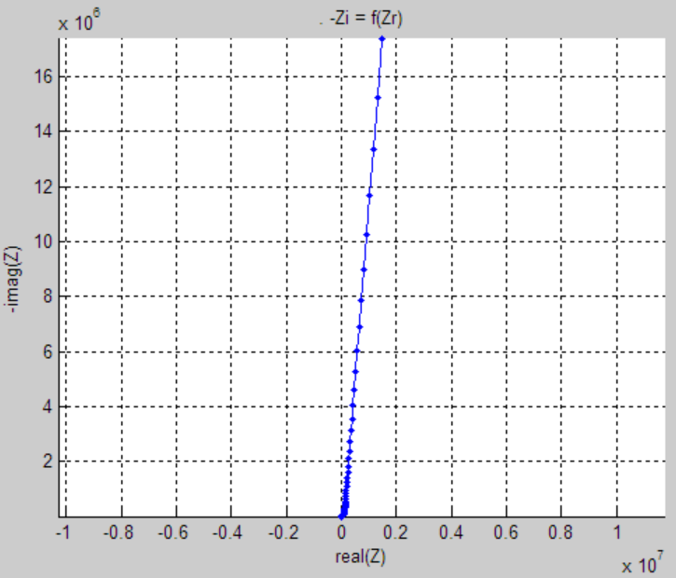
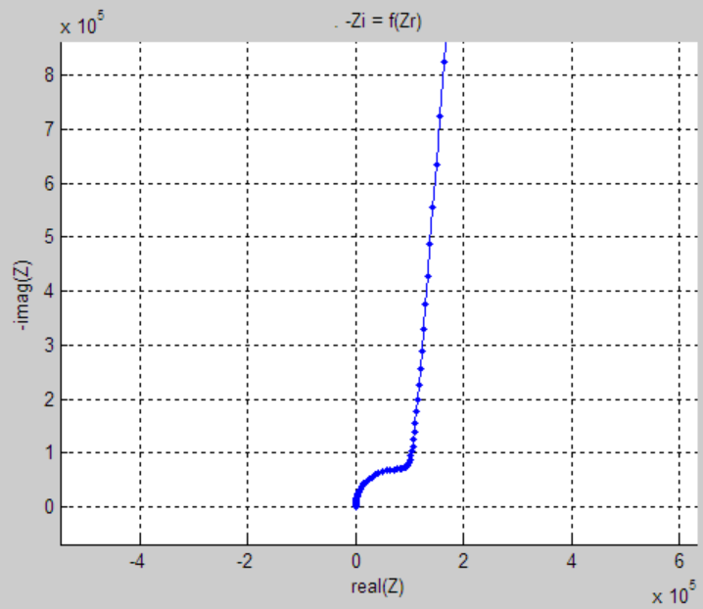
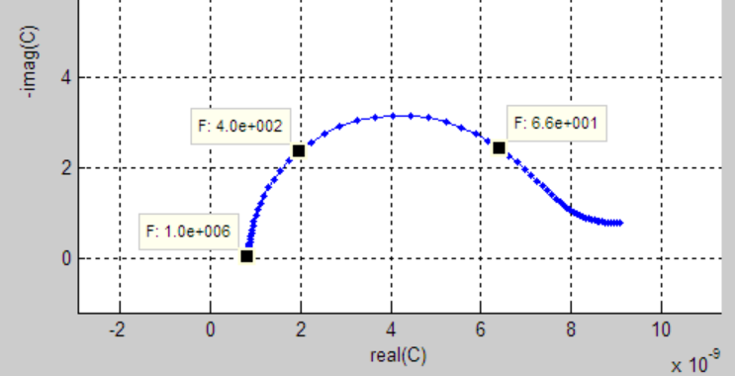



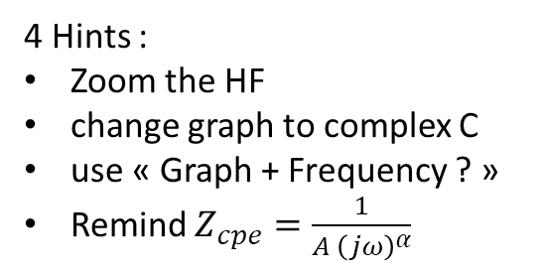

Circuit2 – Simulated Data with an CPE
4 Hints :
Zoom the HF
change graph to complex C
use « Graph + Frequency ? »
Remind $Z_{cpe}=\frac{1}{A {\left(jω\right)}^{α}}$
$$α≈0.9$$
s (p (R1, C1), E2)
Guessed Values obtained from inspection of the graphs
$$r≈1e5$$
Fit …
$$c≈1e−9$$
$$A≈9e−9$$

Slide 12
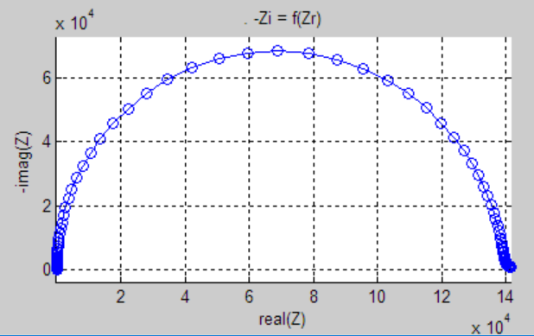
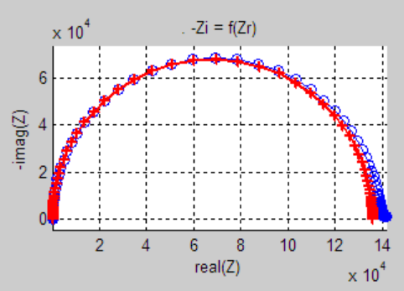
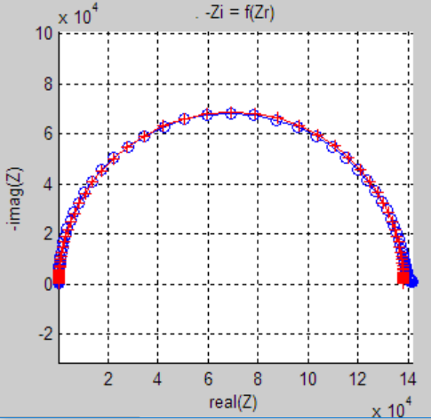
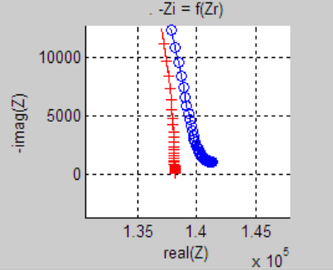
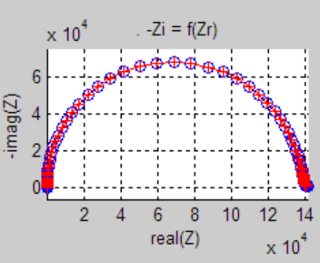
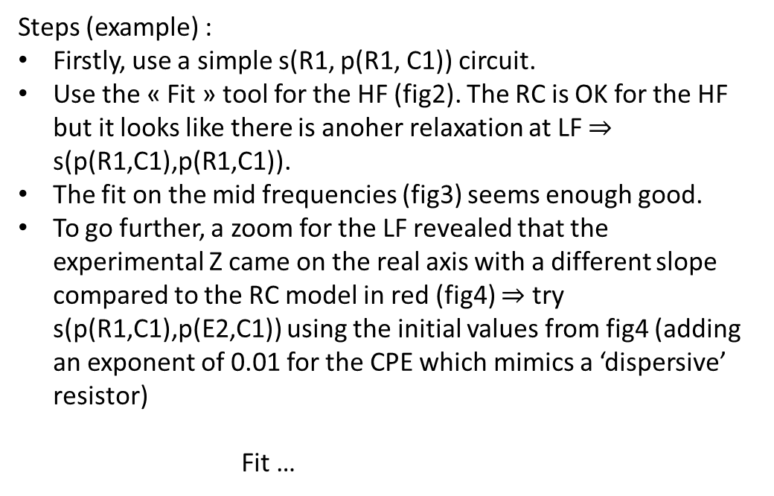
Circuit3 – Simulated Data with low frequency dispersion
Steps (example) :
Firstly, use a simple s(R1, p(R1, C1)) circuit.
Use the « Fit » tool for the HF (fig2). The RC is OK for the HF but it looks like there is anoher relaxation at LF $⇒$ s(p(R1,C1),p(R1,C1)).
The fit on the mid frequencies (fig3) seems enough good.
To go further, a zoom for the LF revealed that the experimental Z came on the real axis with a different slope compared to the RC model in red (fig4) $⇒$ try s(p(R1,C1),p(E2,C1)) using the initial values from fig4 (adding an exponent of 0.01 for the CPE which mimics a ‘dispersive’ resistor)
Fit …
mid frequencies

Slide 13
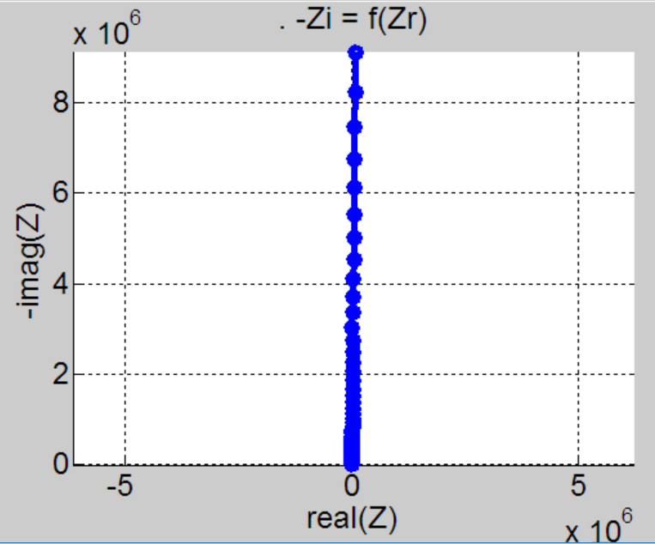
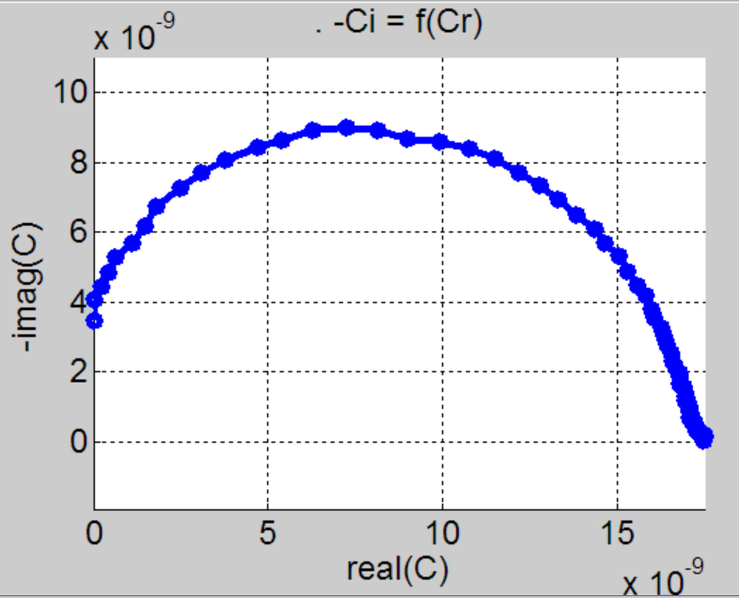
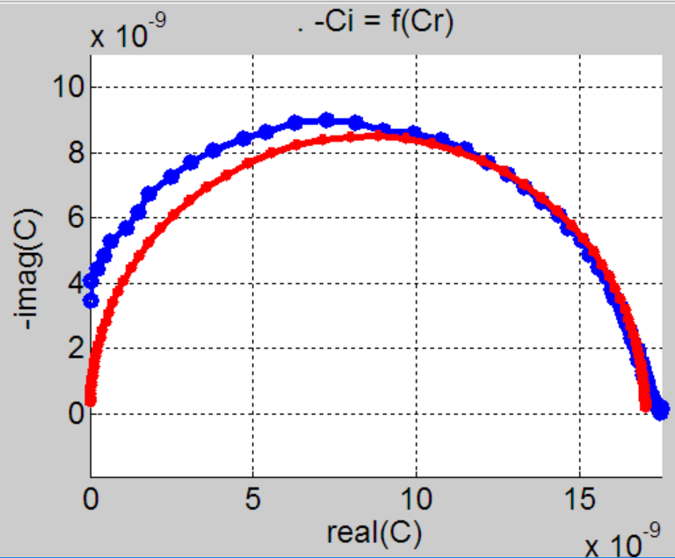
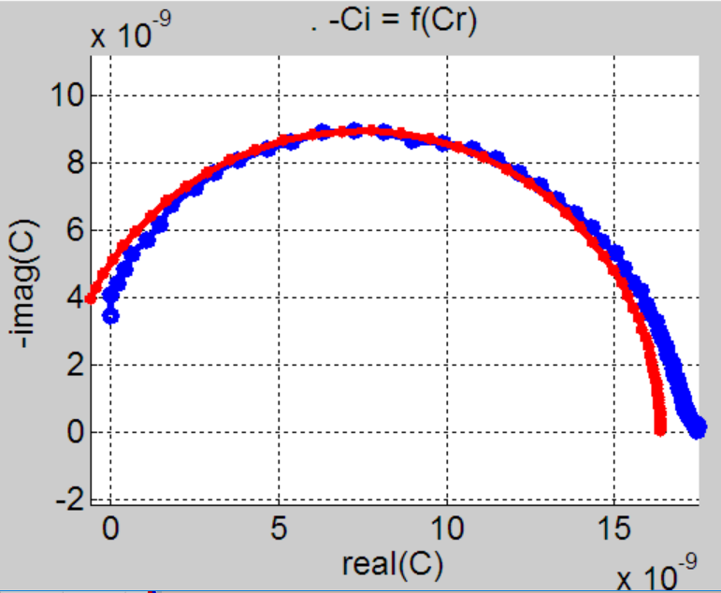
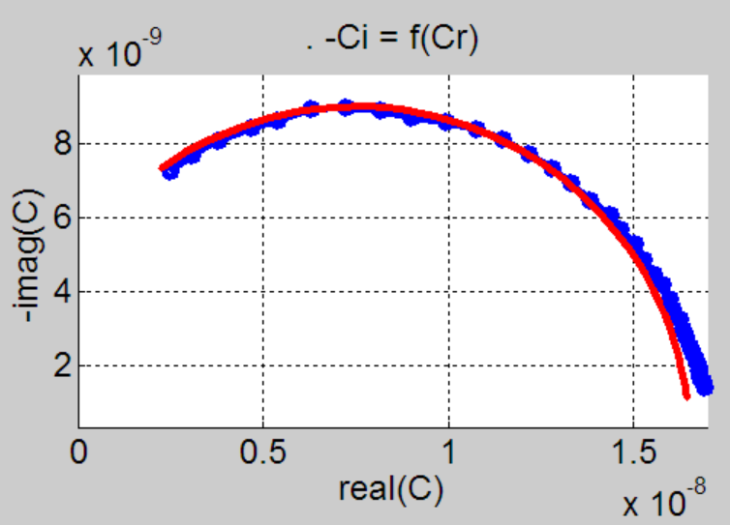
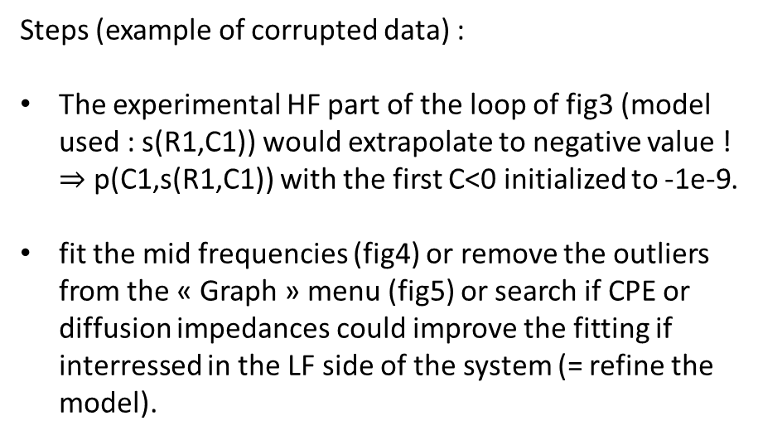
Maruse – Experimental Data
Steps (example of corrupted data) :
The experimental HF part of the loop of fig3 (model used : s(R1,C1)) would extrapolate to negative value ! $⇒$ p(C1,s(R1,C1)) with the first C<0 initialized to -1e-9.
fit the mid frequencies (fig4) or remove the outliers from the « Graph » menu (fig5) or search if CPE or diffusion impedances could improve the fitting if interressed in the LF side of the system (= refine the model).

Slide 14
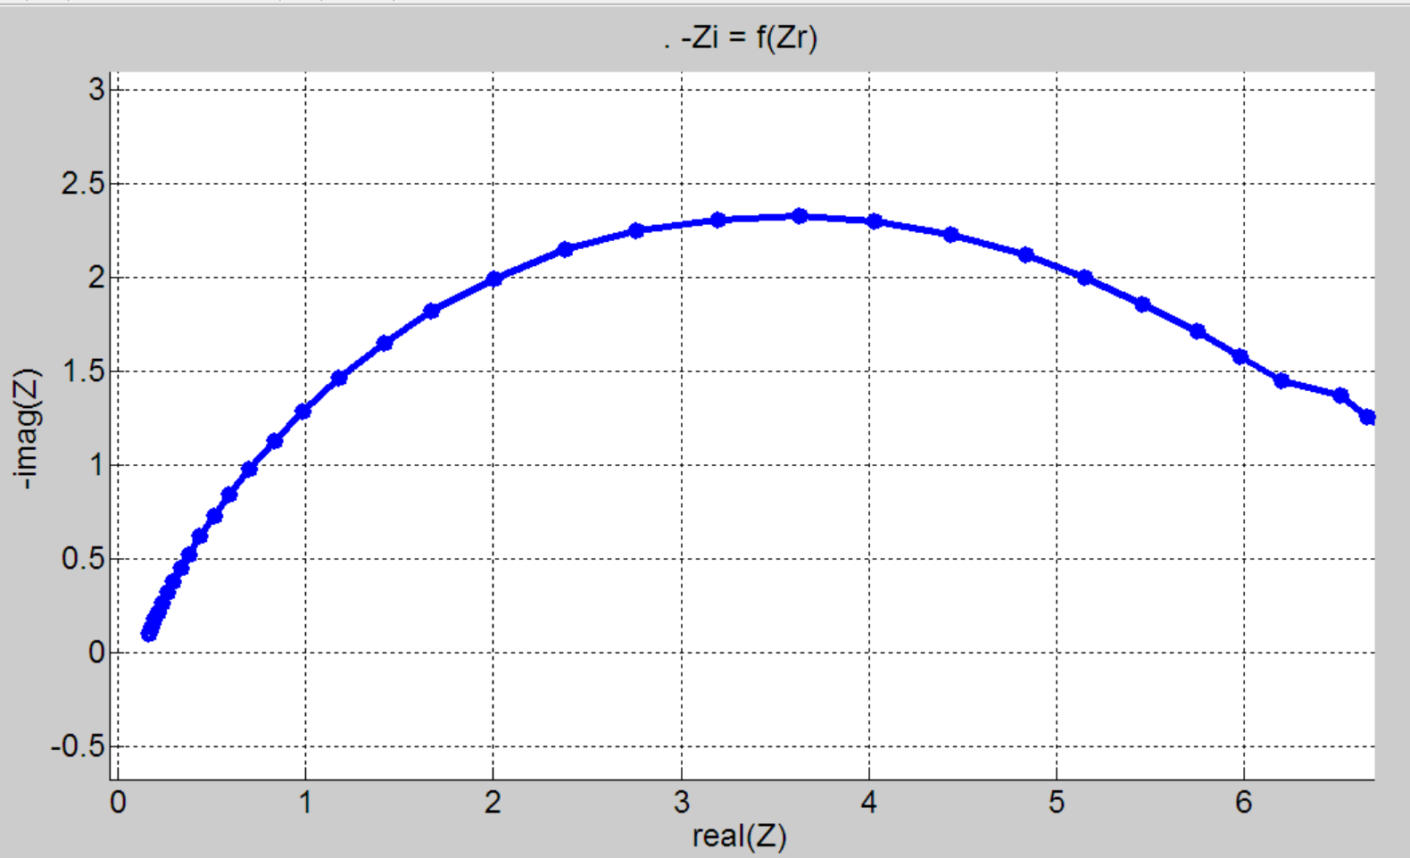
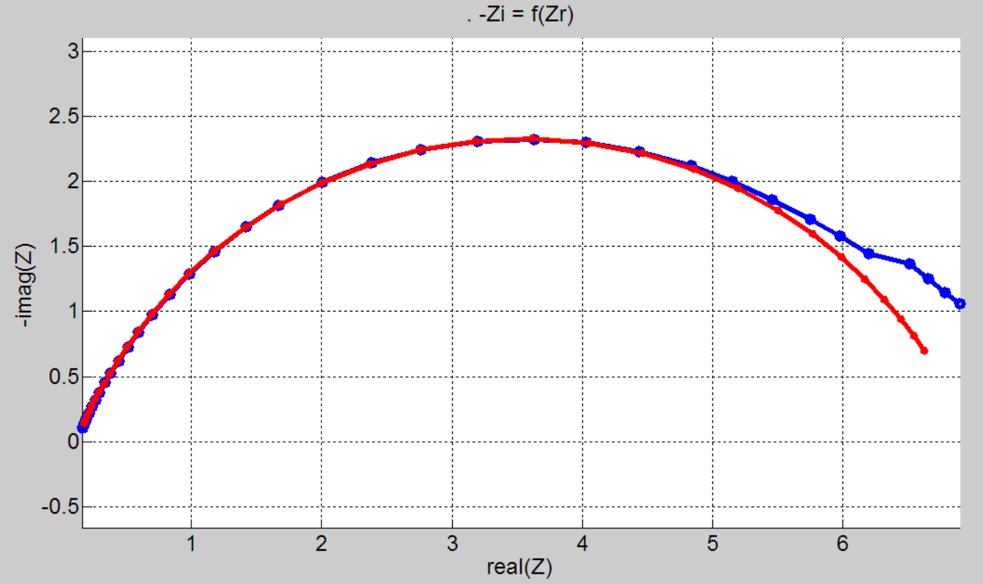

Panata – Experimental Data
Steps (example of corrupted data) :
Remove the HF outliers (with positive Zi).
Note that there is a small translation of the spectrum of $r≈0.1 Ω$ (fig1).
A semi-circle whose the center is located under the real axis can be related to a p(R1,E2) circuit when in Z-representation. Adding the little resistor $r$, one tries s(R1,p(R1,E2))
The initial values are guessed from the Z and the C representations
Fit …
model : s(R1,p(R1,E2))
Khi2 of fit: 2.08e-3
P1 = 1.17e-1
P2 = 6.87e+0
P3 = 1.27e-3
P4 = 7.58e-1
Khi2 is a measure of the distance experimental/model
Because Khi2 depends on the amount N of points taken in the fit, the normalized Khi2/N is displayed in the result figure.

Slide 15



Legreen – Experimental Data – a difficult case
Using the model s(p(R1,C1),p(R1,C1)) and « Fit » on the mid frequencies gave fig1 with
'model : s(p(R1,C1),p(R1,C1))‘
‘Khi2 of fit: 2.37e-2'
'P1 = 2.18e5‘
'P2 = 2.19e-9'
'P3 = 4.43e5‘
'P4 = 5.97e-9‘
Further investigations leads to use a model with a Finite Length Warburg with SHORT Circuit “G2” and a much better result altought using the same amount of parameters (4) :
'model : p(p(R1,C1),G2)‘
‘Khi2 of fit: 9.43e-4'
'P1 = 7.89e5'
'P2 = 1.29e-9'
'P3 = 3.55e-8'
'P4 = 1.55e-1'
mid frequencies
In M representation, the result is very good except at the high frequencies where there is an abnormal behavior with Mr decreasing in the experimental data. Maybe due to the apparatus …
mid frequencies

Slide 16



Ambiguïty of the models
The blue curve named « circle123 » are very similar to the experimental data processed above with a Finite Length Warburg with SHORT Circuit :
p(p(R1,C1),G2)
Try to find the parameters giving the red line which at first glance seems statisfying.
However, watching the real Z-part gave the figure 2 where one can state a gap at the high frequencies. It is also visible when using the M-representation (figure 3).
Read the next slide to know from where circle123 comes…

Slide 17






Producing simulated data
Using the model p(R1,C1) in « circuit », we produced circles 1, 2 and 3. The parameters were successivly :
p(1) = 1e4 then 2e4 and 3e4
p(2) = 1e-9 then 2e-9 and 3e-9
To produce the spectrum of these impedances all put in series « circle123 », the model was :
s(p(R1,C1),p(R1,C1))
with :
1e4,1e-9,2e4,2e-9,3e4,3e-9
[At a fixed frequency $f_{i}$, the point of the resulting spectrum is $z\left(f_{i}\right)=z_{1}\left(f_{i}\right)+z_{2}\left(f_{i}\right)+z_{3}\left(f_{i}\right)$
Beware, the figure shows a special case where the points are aligned but usually they are not]
Try this model on the Legreen data …
$$f_{i}$$
$$f_{i}$$
$$f_{i}$$
$$f_{i}$$

